Slide 1

Introduction to Computer Networks
School of Computer Science Engineering and Technology Bennett University
Greater Noida – 201310

Slide 2
Outline
Computer network basics
Applications of Computer Networks
Transmission media

Slide 3
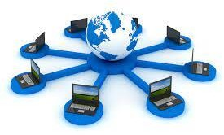
Computer network basics
Network: A set of devices (or nodes) connected by media link is called a Network.
A node can be a device which can send or receiving data generated by other nodes on the network like a computer, printer etc.
The links connecting the devices are called Communication channels.
Computer network is a telecommunication channel used to share data connected to the same
network.
The best example of computer network is Internet.

Slide 4
Computer network application
Marketing and sales: –Marketing professionals collect, exchange, and analyzes data relating to customer requirements and product development cycles.
Teleshopping - Deals with order-entry computers or telephones connected to an order-processing
network, and on-line reservation services for hotels airline and so on.
Manufacturing: – computer-assisted manufacturing (CAM) and computer –assisted designing (CAD) both of which permit multiple users to work on a project simultaneously.
Financial Services: It includes credit history searches, foreign exchange and investment services, and Electronic Funds Transfer (EFT).
Teleconferencing:- Conferences are possible to occur without the participants being in the same place. It includes simple text conferencing, voice conferencing, and video conferencing.
Cable Television:- It can include video on request.

Slide 5
Computer network application
Information Services:- Network information services include bulletin boards and data banks. World
Wide Web site offering the technical specifications for a new product is an information service.
Electronic Messaging:– Electronic mail (e-mail)
Electronic Data Interchange (EDI):– EDI permits business information to be transferred without
using paper.
Directory services: – By using directory services, it is possible to store the last of files in a central location to speed worldwide search operations.
Cellular Telephone: –cellular network make it possible to maintain wireless phone connections
even while travelling over large distances.

Slide 6
Network criteria
Performance - Measured in terms of transit time and response time.
Transit time : It is the time taken to travel a message from one device to another.
Response time : It is defined as the time elapsed between enquiry and response.
Other ways to measure performance are :
Efficiency of software
Number of users
Capability of connected hardware
Reliability - Frequency of failure, recovery from failures, and robustness during catastrophe
Scalability – Can grow/shrink according to need
Security - Protecting data from unauthorized access. .

Slide 7
Data Communication
The exchange of data between two devices through a transmission medium is called Data Communication.
Communication Types:
Local communication: The communicating devices are in the same geographical area, same building, or face-to-face etc.
Remote communication: The devices are communicating over a distance
The effectiveness of a data communication can be measured through the following features :
Delivery: Delivery should be done to the correct destination.
Timeliness: Delivery should be on time.
Accuracy: Data delivered should be accurate.

Slide 8
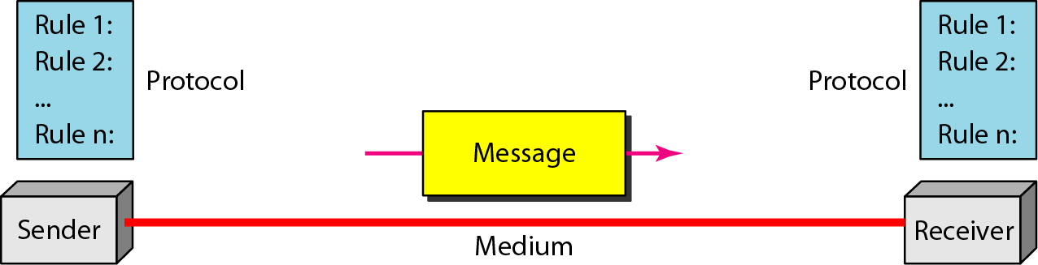
Data communication: Components
Message: It is the information to be delivered.
Sender: Sender is the person who is sending the message.
Receiver: Receiver is the person to whom the message is being sent to.
Medium: It is the medium through which the message is sent. For example: A Modem.
Protocol: These are some set of rules which govern data communication.

Slide 9
Connection types
A Network is nothing, but a connection made through connection links between two or more devices.
There are two ways to connect the devices :
Point-to-Point connection or dedicated connection
Multipoint connection or shared connection

Slide 10
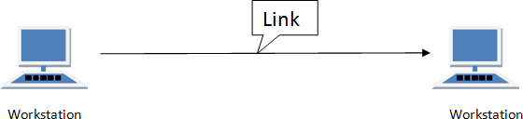
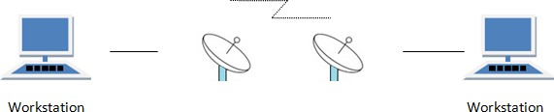
Connection types: Point to point
Communication link between two devices and it is simple to establish.
E.g., computer connected by telephone line, connection between remote control and Television.

Slide 11
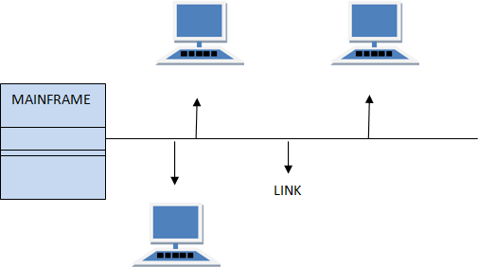
Connection types: Multipoint
The link is shared in space shared, or time shared between many devices

Slide 12
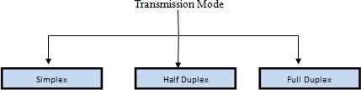
Transmission Modes
Transmission mode refers to the mechanism of transferring of data between two devices connected over a network.
These modes direct the direction of flow of information.

Slide 13

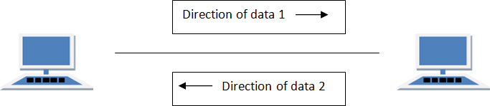
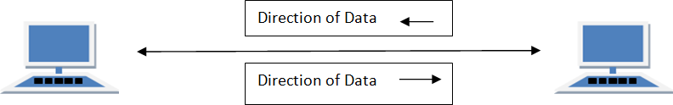
Transmission Modes
Simplex mode:
E.g. loudspeakers, television broadcasting, television and remote, keyboard and monitor
Half Duplex mode:
E.g. walkie- talkie, workstation data transmission
Full Duplex mode:
E.g. telephone network, skype, video call

Slide 14
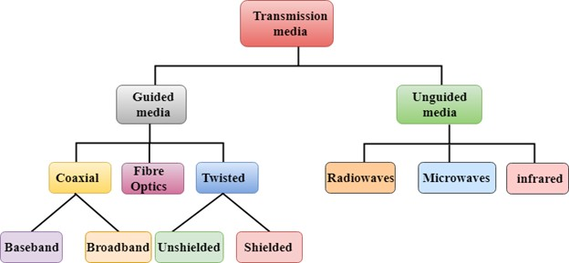
Transmission Media
The function of the media is to carry information through a LAN.
Following types:

Slide 15
Transmission Media : Guided
A signal travelling along guided media is directed and contained by the physical limits of the medium.
Twisted-pair and coaxial cable use metallic (copper) conductors that accept and transport signals in the form of electric current.
Optical fiber is a cable that accepts and transports signals in the form of light.

Slide 16
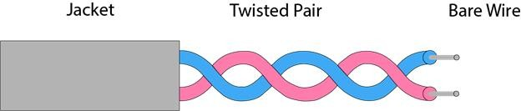
Guided : Twisted pair cable
A physical media made up of a pair of cables twisted with each other.
A twisted pair cable is cheap as compared to other transmission media.
Installation of the twisted pair cable is easy, and it is a lightweight cable.
A pair of wire is twisted over a double helix.

Slide 17
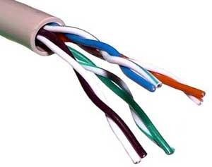
Guided : Unshielded twisted pair (UTP)
This type of cable can block interference and does not depend on a physical shield for this purpose.
UTP has seven categories, each suitable for specific use.
In computer network,Cat-5, Cat-5e, and Cat-6 cables are mostly used.
UTP cables are connected by RJ45 connectors.

Slide 18
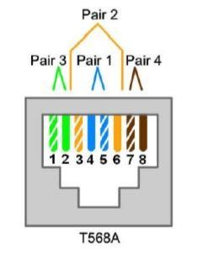
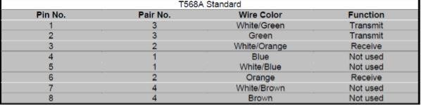
Guided : Unshielded twisted pair (UTP)
Advantages:
It is cheap.
Installation of the unshielded twisted pair is easy.
It can be used for high-speed LAN.
Disadvantage:
This cable can only be used for shorter distances because of attenuation.
Liable to exterior interference
Less capacity

Slide 19
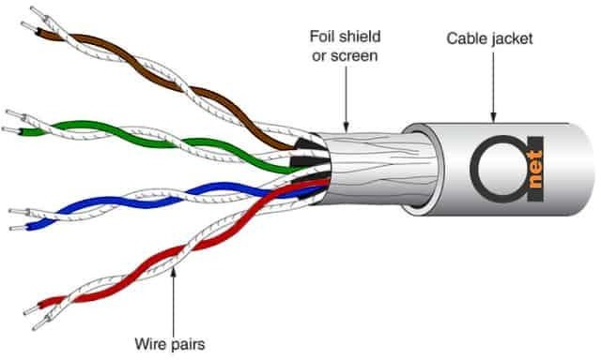
Guided : Shielded twisted pair (STP)
STP cable includes a particular jacket for blocking outside interference.
It is used in rapid data rate Ethernet, in voice & data channels of telephone lines.
Advantages:
Better performance at a higher data rate in comparison to UTP
Eliminates crosstalk
Comparatively faster
Disadvantages
Comparatively difficult to install and manufacture
More expensive
Bulky

Slide 20
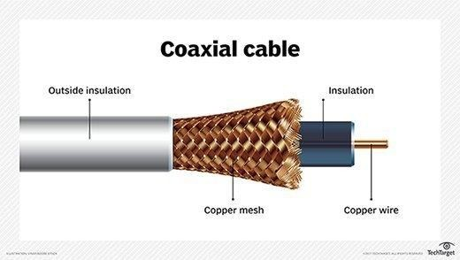
Guided : Coaxial
Coaxial - It contains two conductors parallel to each other.
The inner conductor is made up of copper, and the outer conductor is made up of copper mesh.
The middle core is made up of non-conductive cover that separates the inner conductor from the outer one and is responsible for the data transferring whereas the copper mesh prevents from Electromagnetic interference.
There are three categories of coax cables namely, RG-59 (Cable TV), RG-58 (Thin Ethernet), and RG-11 (Thick Ethernet). RG stands for Radio Government.

Slide 21
Guided : Coaxial
Provides high bandwidth rates of up to 450 MBPS.
Advantage
The data can be transmitted at high speed. Better shielding as compared to twisted pair cable. It provides higher bandwidth. Used for broadband transmission
Cables are connected using and
BNC connector
BNC-T.
BNC terminator is used to terminate the wire at the far ends.
Coaxial cable transmission is of two types:
Baseband transmission: Transmitting a single signal at high speed.
Broadband transmission: Transmitting multiple signals simultaneously.
Disadvantage
More expensive as compared to twisted pair cable. If any fault occurs in the cable causes the failure in the entire network

Slide 22
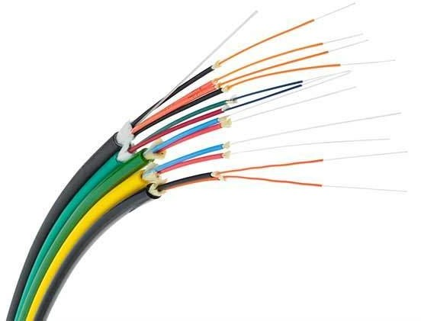
Guided : Fiber Optic
It works on the properties of light and provides highest speed.
The core is made of high-quality glass or plastic. From one end of it light is emitted, it travels through it and at the other end light detector detects light stream and converts it to electric data.
The plastic coating protects the optical fibers from heat, cold, electromagnetic interference from other types of wiring.
Data transfer modes:
Single mode fiber: Carry a single ray of light
Multimode fiber: Carry multiple beams of light.

Slide 23
Guided : Fiber optic
Advantage
Greater Bandwidth Faster speed Longer distances Better Thinner and Sturdier
Components:
Core: Narrow strand of glass or plastic and is a light transmission area of the fiber.
Cladding: The concentric layer of glass. It provides the lower refractive index at the core interface as to cause the reflection within the core.
Jacket: The protective coating consisting of plastic.
To connect and access fiber optic special type of connectors are used. These can be Subscriber Channel (SC), Straight Tip (ST), or MT-RJ.
Disadvantage
It is more expensive as compared copper cable Fragile Installation & maintenance is difficult

Slide 24
References
https://www.electronicsmedia.info/2021/04/17/what-are-the-various-applications-of- computer-networks/
https://www.studytonight.com/computer-networks/uses-of-computer-networks
https://www.javatpoint.com/guided-transmission-media
https://www.geeksforgeeks.org/types-transmission-media/
https://www.elprocus.com/what-is-transmission-media-in-computer-networks-its-types/
https://www.tutorialspoint.com/data_communication_computer_network/transmission_medi a.htm

